Slide 1
Eugenics
Kathleen A. Nolan, Ph.D.
St. Francis College, Brooklyn, NY 11201
BIO 3303 Genetics class

Slide 2
Who were the people who started the eugenics movement?
Francis Galton (1822–1911), the originator of eugenics as a concept, and the man who coined the term itself (meaning well, or truly born). Great Britain
Charles Davenport, USA—in 1910
Founder of the Eugenics Record Office (hereafter ERO) (funded initially by the Harriman family of New York in 1910, and after 1916 by the Carnegie Institution) at
Cold Spring Harbor Laboratory, New York.
Frances Laughlin helped promote sterilization laws
James Watson worked at CSHL---they cut ties with him

Slide 3
1900-1950 and beyond??
It was “thought” that genes control:
polydactyly and eye color
physiological conditions such as the A-B-O blood groups
mental and personality traits such as “feeblemindedness,” alcoholism and pauperism

Slide 4
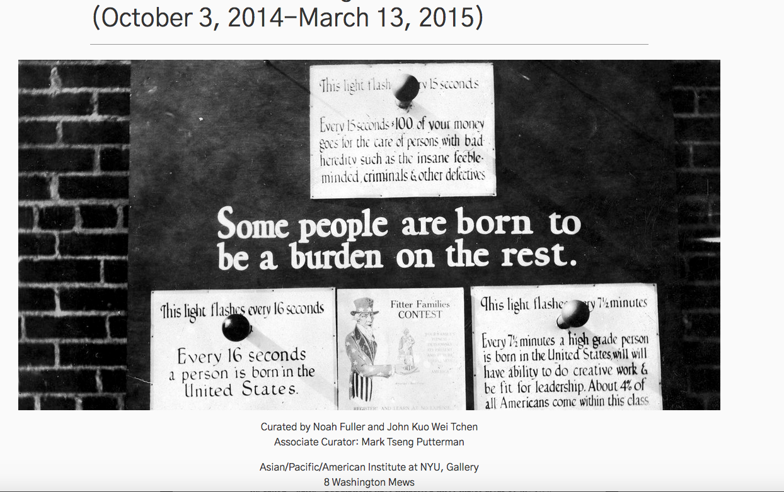

Slide 5
Almost 100 years ago, eugenicists were very concerned with race mixing. In 1913, 29 states had laws forbidding mixed-race marriages, and 22 penalized for miscegenation — with fines and/or prison terms. Eugenicists actively supported the strengthening of old laws and the enactment of new ones such as the Virginia Integrity Act of 1924, which prohibited marriage between a white person and anyone with a trace of blood other than Caucasian. It took until 1967 for these laws to be dissolved.

Slide 6
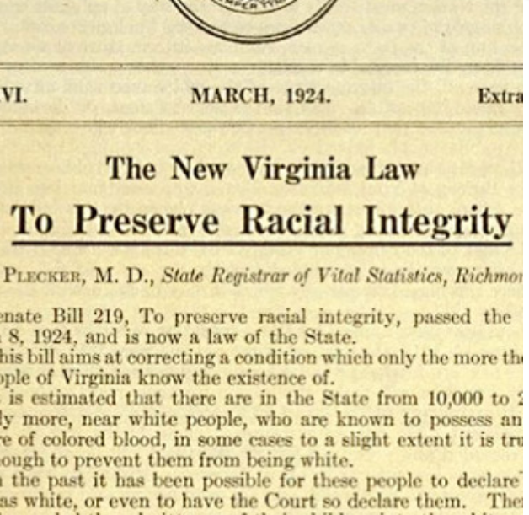

Slide 7
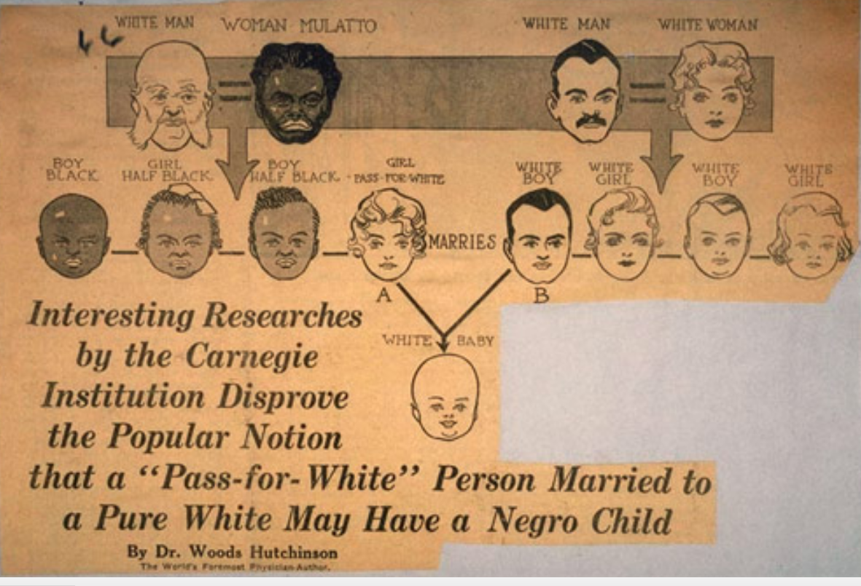

Slide 8
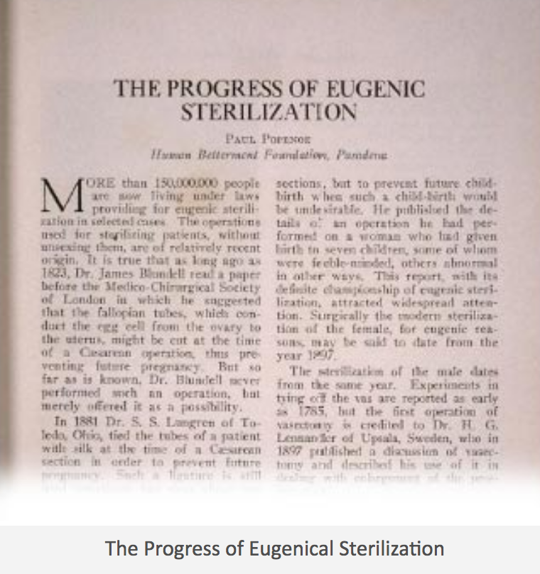

Slide 9
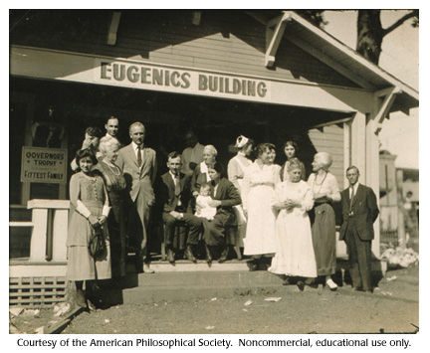
Fitter Family Contests

Slide 10
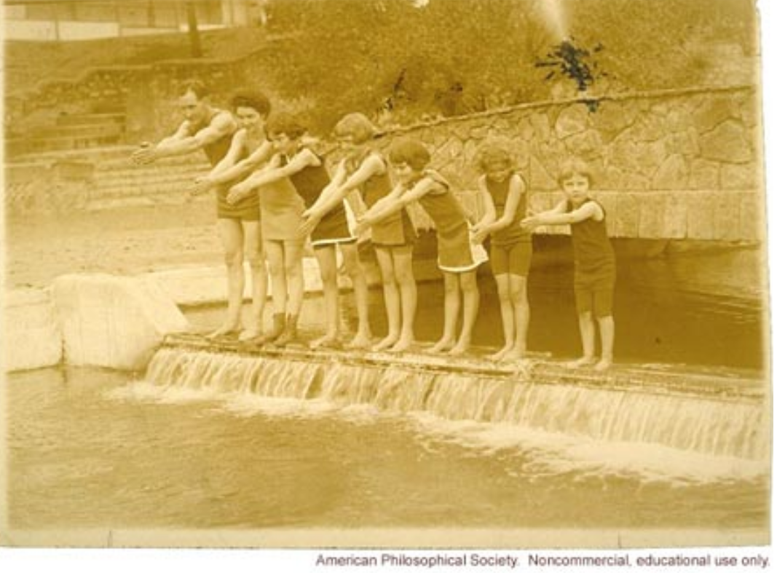

Slide 11
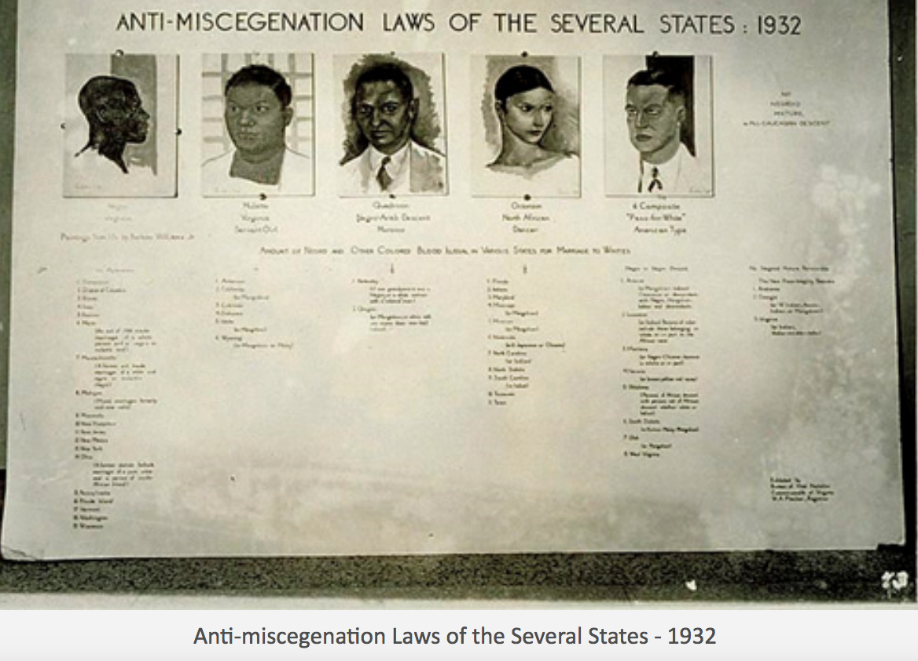

Slide 12
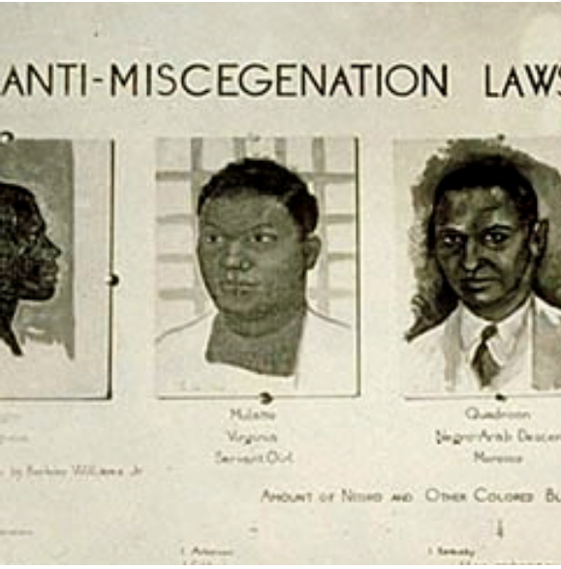

Slide 13
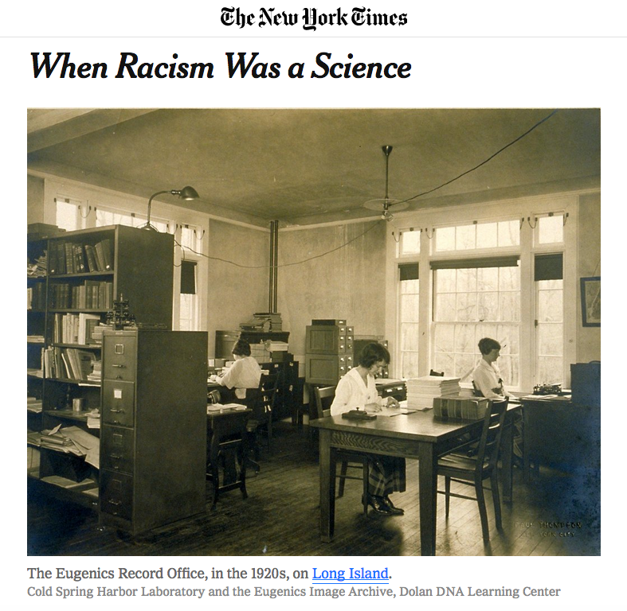

Slide 14
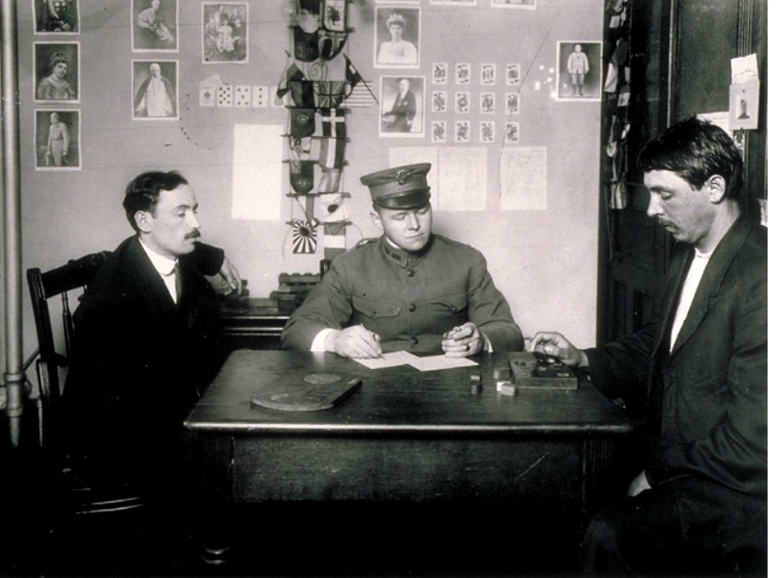

Slide 15
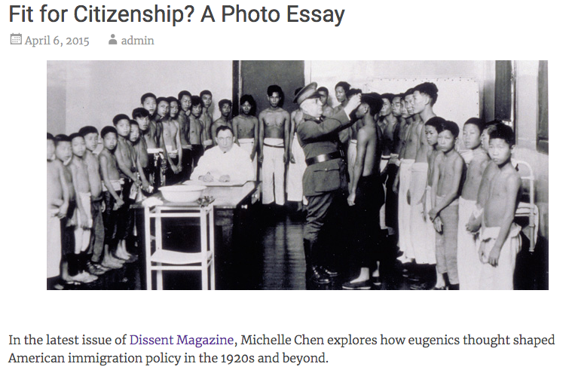

Slide 16
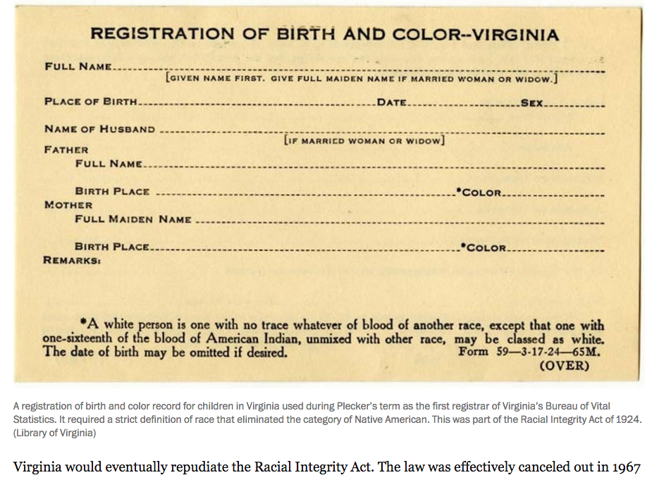

Slide 17
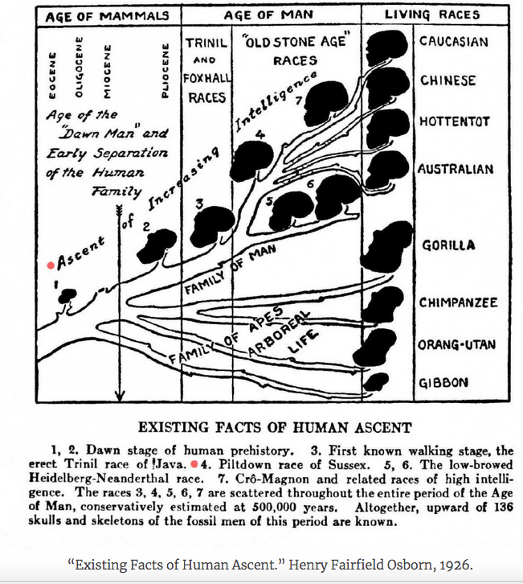

Slide 18
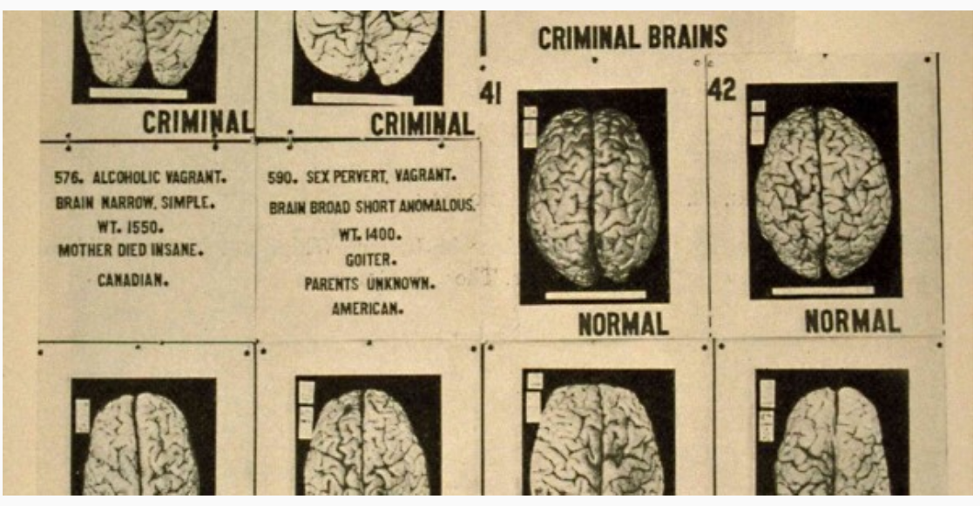

Slide 19
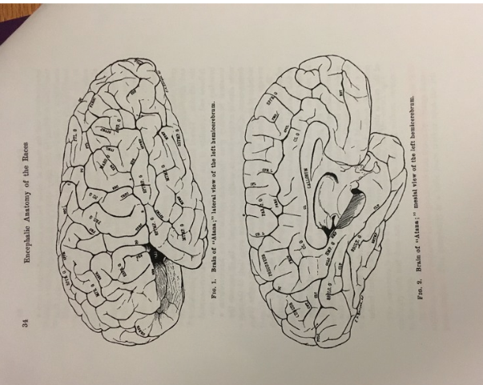

Slide 20
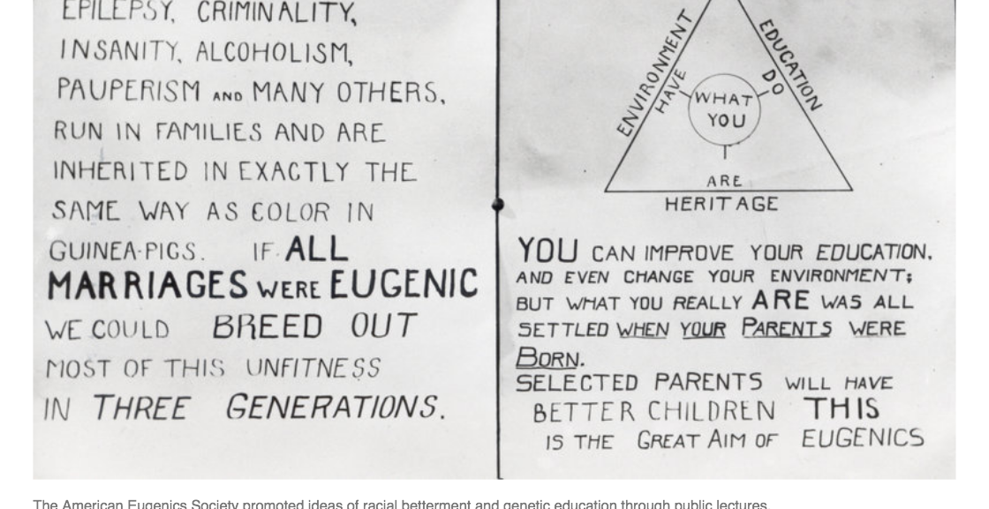

Slide 21
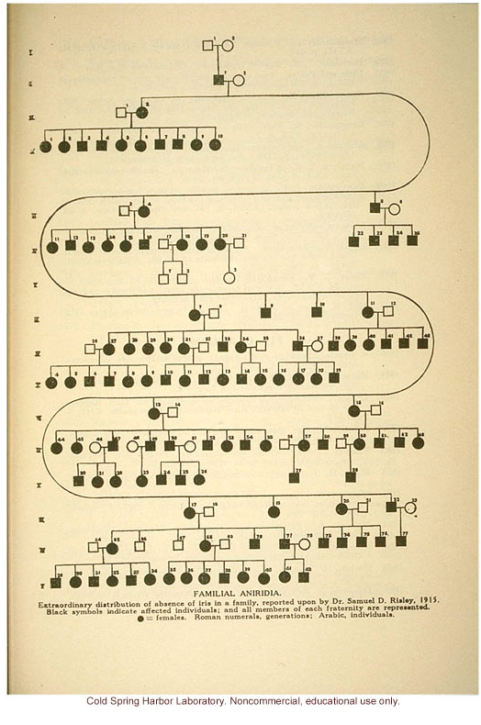

Slide 22
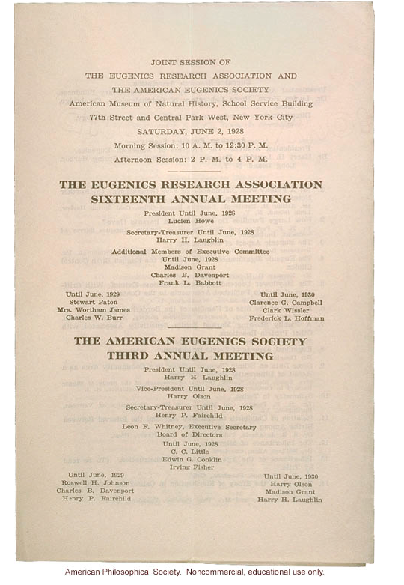

Slide 23
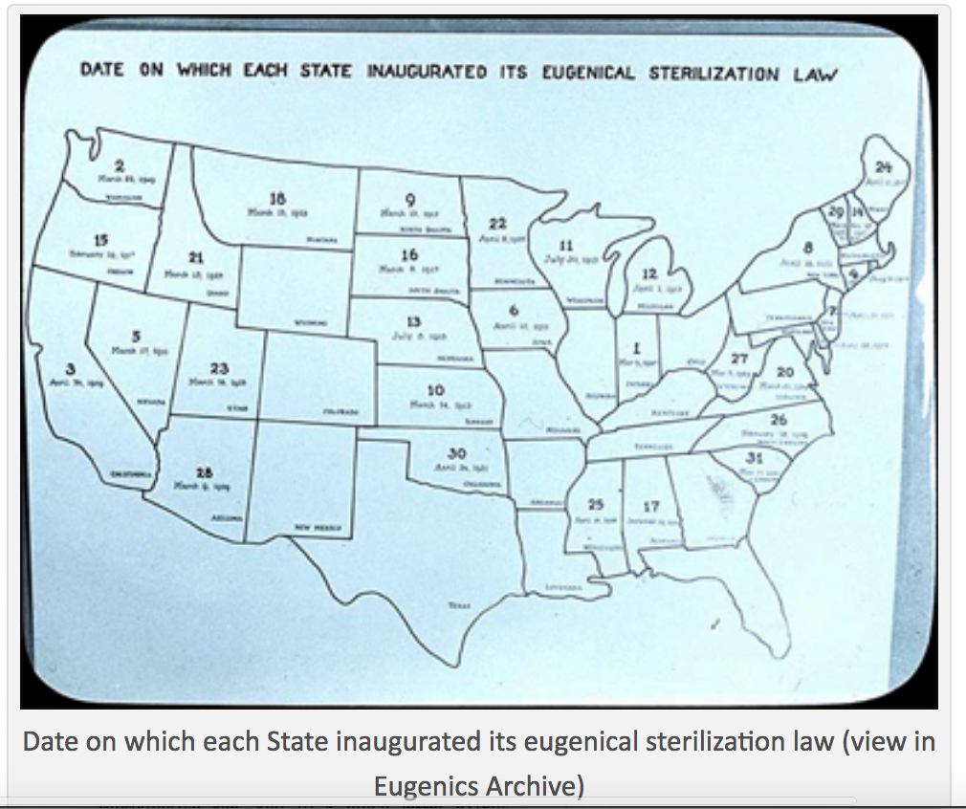

Slide 24
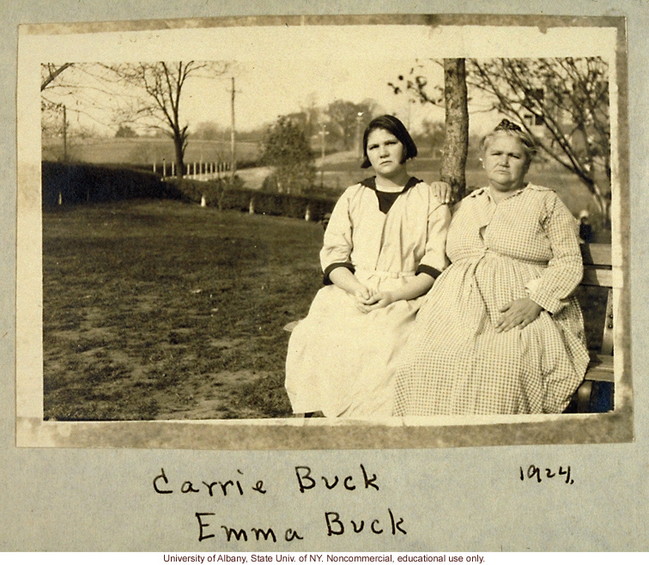

Slide 25
US Supreme Court text of 1927 Buck v Bell decision
The case involved the sterilization of mainly teenagers at the Lynchburg Colony. Virginia's Eugenics laws of 1924 were later used as model legislation in Germany in the 1930s after the Nazi's came to power.

Slide 26
Carrie and Emma Buck at the Virginia Colony for Epileptics and Feebleminded, Lynchburg, Virginia, taken by A.H. Estabrook the day before the Buck v. Bell trial in Virginia
http://www.eugenicsarchive.org/html/eugenics/static/themes/39.html

Slide 27
Oliver Wendell Holmes, Jr., included the infamous phrase "Three generations of imbeciles are enough."

Slide 28
What lead to its decline?

Slide 29
youtubes
‪Eugenicist Movement in America: Victims Coming Forward‬
https://www.youtube.com/watch?v=Nshj9rCTPdE
‪Forced Sterilization : Eugenics in America CNN (March 08, 2012)‬
https://www.youtube.com/watch?v=rcYXB0zZjpY
Crash course in Eugenics
https://www.youtube.com/watch?v=JeCKftkNKJ0
There were forced sterilization laws in 35 states

Slide 30
Other forms of “eugenics”
I.Q. scores between blacks and whites in the United States was due to genetics (Arthur Jensen, 1969)
The Bell Curve—Richard Hernstein and Charles Murray--1994
Male/female differences in math aptitude---spatial reasoning
Extreme caution should be placed against stereotypes

Slide 31
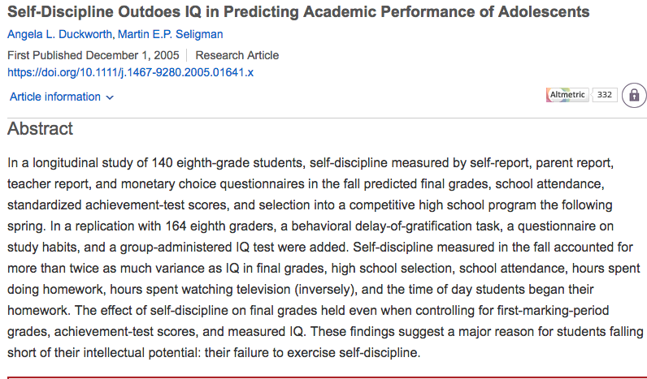

Slide 32


Slide 33
Article
How Organizers Are Fighting an American Legacy of Forced Sterilization---Yes! Solutions Journalism
BY RAY LEVY UYEDA
6 MIN READ
2/8/2021
https://www.yesmagazine.org/social-justice/2021/02/08/united-states-forced-sterilization-women

